Slide 1

CA22123 EU-MACE: Core Group monthly update GP3 #5
Virtual
10/03/2026

Slide 2
Hello!
Today’ meeting is recorded!

Slide 3
0. welcome
Summary from MC and WS
Agenda & MC decisions
WS take-home messages
Periodic Report Review
Updates from tasks
ERASMUS+ other training program building
Legacy Lab2
Young EU-MACE/Expert
MAP list
Next meeting dates
Young EU-MACE webinar GP3 n°1: Michal Strozik

Slide 4
MC 1 & WorkShop: summary

Slide 5
agnda
EU-MACE MC1 meeting &
Joint workshop (EERA-AMPEA&E3S):
Sustainability in next generation energy materials and technologies
When: February 23-25, 2026
Where: Maison Irène & Frédéric Joliot Curie, Brussels (and online)
Format: Hybrid - 52 attendees (F2F: 26 & online: 26)
Purpose: Create synergy and initiate collaborations between materials scientists and sustainability experts (including social science field)
Organization: HEU 2026-2027 CL4 & CL5 calls were used to structure the topic
Presentations: Research ideas on energy materials research and sustainability assessment (needs and expertise propositions)
Registeration: 20 presentation interests, 40 listeners

Slide 6

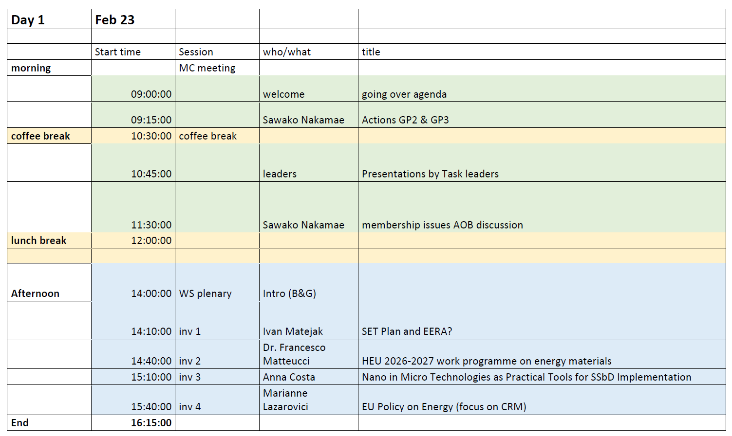
Invited
speakers

Slide 7
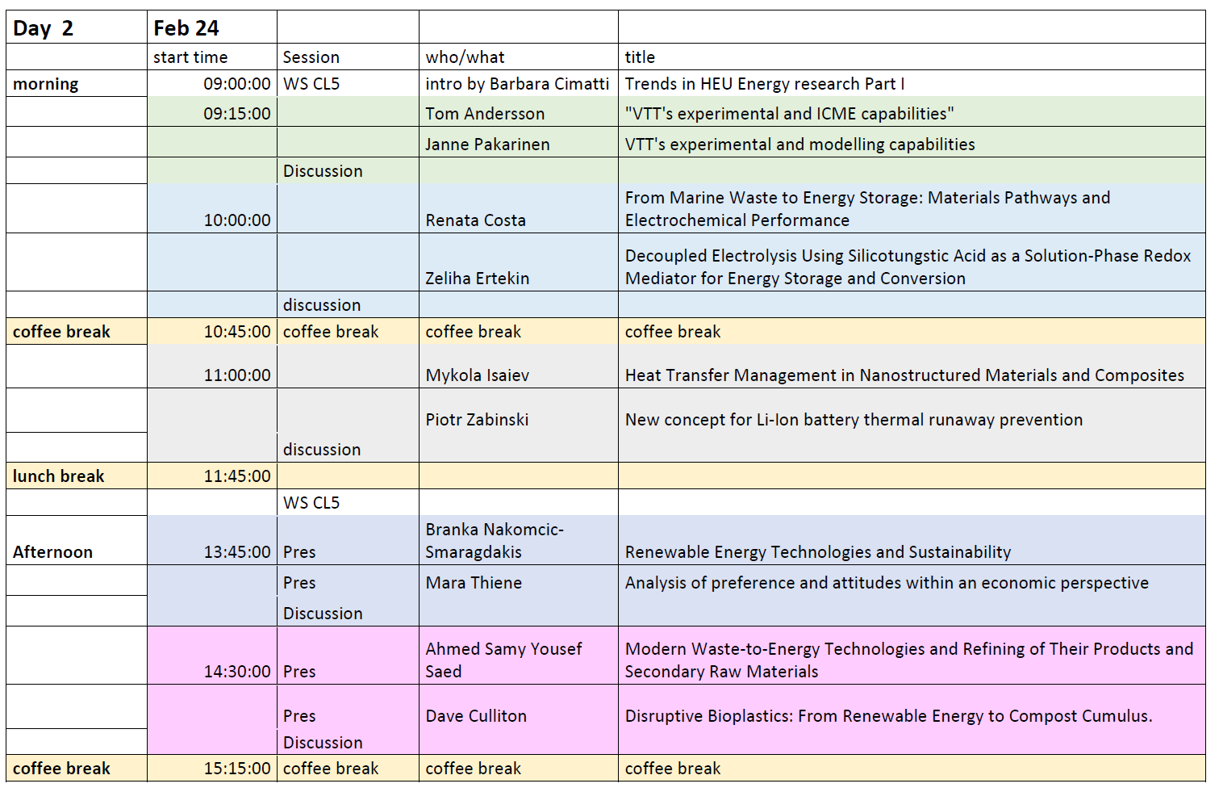
E3S & sustainability
researchers
speakers

Slide 8
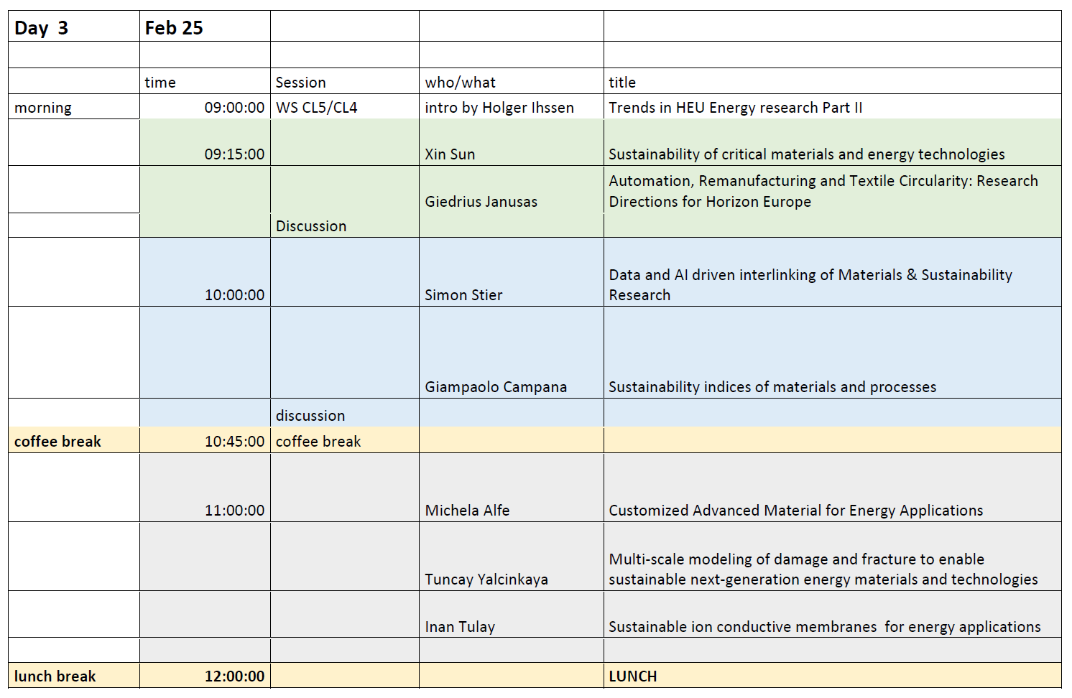
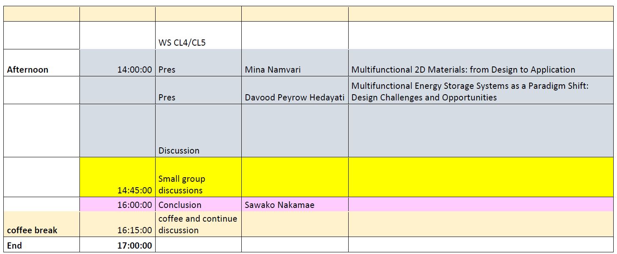
E3S & sustainability
researchers

Slide 9
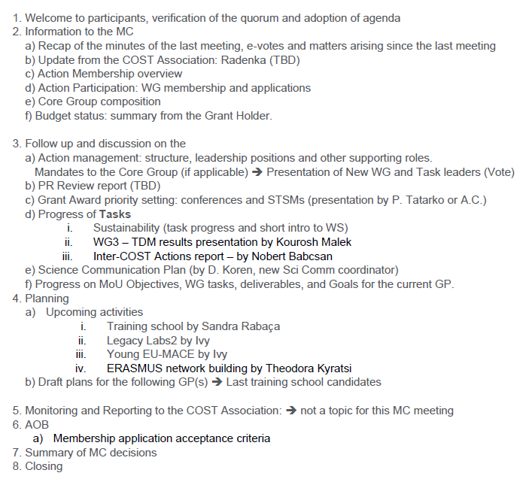
MC meeting agenda
Quorum not reached ➔
3 e-VOTES to be launched for MC approval
All presentation files + meeting minutes are shared ➔ PLEASE Review!!

Slide 10
Key messages and inputs needed
Conference grants: need to choose « priority conferences »!
NuMat2026
MSE2026
3Nano2026
…. We will discuss among Grant Award committee: Peter Tatarko, Monica F., Antonio.P. G., Tugba L. and me in the next fiew days! And it will be announced and Grant will be opened for application. Please hurry!!!
Inter-COST Actions:
Norbert is assembling a team for liaising with other Action member ➔ see presentation file for more detail
To join: https://forms.office.com/e/3gArV3xVnC
Young EU-MACE webinar series (leader = Ivy T.)
Re-starting today! March/April/May speakers identified
Announced on our website and LinkedIn + Slack
Gives visibility and encourages future collaborations
Want to present? Enlist YRI from your lab ➔ contact Ivy T. <Min.Ying.Tsang@port.lukasiewicz.gov.pl>
https://forms.office.com/e/0XmDMGzdFQ
For all other discussion/presentation items, please download and see minutes & presentation files

Slide 11
Membership ‘acceptance’ criteria
Avoid geographical over-representaiton
Limit a single-country percentage to 20%
Exceptions: Invited speakers, or those with strong alignment with the Action & contribution potential ➔ to be consulted with the MC members of the respective countries
Stop COST Action ‘predetors’
Limit max number of COST Action per person: max set to 4
Set max member to 450 ➔ not included in the vote
Screening
Careful examination of each application takes time
1st layer Screening with Keywords: acceleration, automation, sustainability, digitalization… (in addition to energy materials) by AC
2nd screening by MC members of the respective countries

Slide 12
Workshop take-home messages

Slide 13
Following 19 presentations and discussions…
A group on ‘batteries’ topic formed (facilitator = B. Cimatti (UniBo))
Feedback surveys/ co-work style ➔ Max Wolf (AIT) prepare Airtable database for follow-up communications
Recordings and presentation files
Recordings are being compiled. Both will be shared via WS mailing list (non-transferable)
Want to access? Email GHM «d.koren@eera-set.eu »
Brokerage event of E3S ➔ will propose a couple calls with descriptions and needs of SSH expertise to Margherita/Alessandro
Industrial participation ➔ to discuss
Invite SME’s and industries (from IAM-I list? Any other idea?) to EU-MACE event
Gather industrial members of EU-MACE
What else?

Slide 14
Periodic Review Report
Prof Chris Bowen
University of Bath
United Kingdom

Slide 15
Review report received on Feb 20
Rapporteur summarised the Actions's plans:
Clear action plans are logical in an attempt to overcome identified challenges
MoU objectives & Deliverables
The Rapporteur confirmed the level of progress reported by the Action for all objectives
The level of ambition of the MoU objectives & deliverables are High.
Overall, all MoU Objectives & all deliverables are progressing appropriately
Co-authored Action publications, Projects and proposals resulting from Action activities:
Quality, Significance, Relevance & Quantity: very good (quantity = good)
Impacts:
Multiple highly significant impacts are reasonably foreseen for the future OR one highly or moderately
significant impact is already observed [Very Good]

Slide 16
Review report received on Feb 20
Dissemination & Exploitation:
Good clear website with clear outline of Materials Acceleration Platforms, Schools, Grants, Calls, Events, News items, and the Tools developed. Clear links to social media - eg. LinkedIn
To dissemination and exploitation approach is a logical approach to engage with community and extend activity beyond the COST action lifetime. Good to see links to wider community, including policy
All Action activities focusing on dissemination of Action results were effective [Very Good]
Other matters (difficulties)
Silent observers, or passengers, are noted. Slack is good approach and may also help identifying the active and more useful members of the COST action. Spending profile and membership profile noted and key is to identify and adapt plans in light of these challenges - this seems to be in place. [Text in Action plans now noted - good].

Slide 17
Task updates

Slide 18
Ongoing actions
AcceLMAPs: Sandra/Ana/Antonio
Application opened ~20/01/2026 and open until Feb 28 ➔ now closed
Applications being examined ➔ next meeting = March 13th
Decision letters to be sent on March 21st
ERASMUS+ and other training programme building (you can still join): https://forms.office.com/e/2b0DmVgyAV
2nd meeting on March 9th ➔ 2 ideas are emerging
Next meeting in early April ➔ more concrete idea propositions will be formulated
To be presented at the next monthly update meeting to recruit more members
TDM (WG3)
Draft to be circulated among core group members
ChainMAP
Expansion to include Research infrastructures and technologies
Please help!!! https://forms.office.com/e/E0CEWhJWbT
Inter-COST
Sign up! https://forms.office.com/e/3gArV3xVnC
Contacted by EU-MINe and DAEMON ➔ meeting will be organized soon

Slide 19
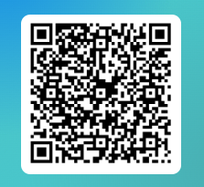
LegacyLab 2 – March update
Defined expectation in LL2
Legacy Labs:
Collaborate with MAPs to accelerate workflows and productivity for development of materials
MAPs:
Increase collab. between MAP and Lab
Increase collab. between MAPs
Simulations:
Connect legacy labs with MAPs
Incorporate simulation and AI with high-throughput screening
Engage to materials in Lab
Sim-data management
MAP-synthesis
MAP-characterization
Sim-Material discovery
Sim-Material properties
Lab-synthesis
Lab-characterization
Up-coming plan and activities:
Online meeting in March (separate email will be sent)
Narrow down focus for STSM (specific HEU calls, target applications)
Legacy Lab 2 – Fill in form
by 17th March. (Tue)

Slide 20
Next meetings

Slide 21
Next MC/CG monthly update meetings
2nd or 3rd Tuesday of each month @ 3pm
March 10th 2026:
Recap of MC meeting+PR review report, Grant award publication...
Young EU-MACE seminar
April 14th:
Update on AccelMAPs preparation, ERASMUS progress… + YEM webinar
May 12th:
Inter-COST Actions, TDM white paper, etc. etc.
Thank you for your attention!

Slide 22

Michał Stróżyk (NCBJ, Poland) – winner of YRI CG – GP2!
Characterisation of Metallic Materials
for Extreme Environments

Slide 23
Additional slides from before

Slide 24
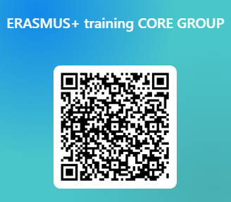
Task update cont’d
ERASMUS
First meeting next week! (10 ppl signed up
Still possible to join: https://forms.office.com/Pages/ResponsePage.aspx?id=9xZkbOgxIEWCTMuTP4OQuXsjyL-l515MkDTrXz9gtT5UMjVCNUNROVkyTlRKM0dHRTlFWDhRWVc2RS4u
Young EU-MACE seminar series
2 speaker candidates
Will re-start on March 10
Want to propose a student/post-doc from your lab? Contact Ivy!!
ChainMap upgrade
Periodic Review reviewer examined ChainMap
Will organize a meeting with Kourosh, Iosif, Monica, Saco & Bogdan ➔ have not done!!! Sorry….
Willing to contribute? Email Saco

Slide 25
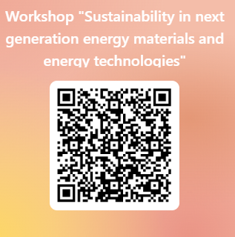
AOB
Open discussion
Questions??
NEXT monthly update meetings: Second Tuesday at 3pm
Feb 10
March 10
April 14
May 12
See you all at MC meeting and Workshop! Don’t forget to register today!!!!
https://forms.office.com/Pages/ResponsePage.aspx?id=9xZkbOgxIEWCTMuTP4OQua30uxW7CP5Ki2iESeIBm99UNVFaOEZKSTRNT09LSEVWNUFaTjVXVUU1QS4u

Slide 26
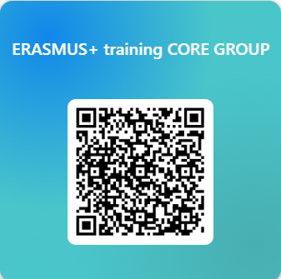
WG4 (training) – ERASMUS program building
ERASMUS+ discussion meeting (WG4): leader = Th. Kyratsi (CY) for now
ERASMUS+ or a similar network ➔ Action Deliverable and objective for GP4
Call for interests launched in December 2025: Only 6?
Plus Theodora
As a non degree-granting affiliate, AC will be only an observer
Online meetings starting in March 2026 to
Compare existing course programmes of interested members
Propose ‘new’ courses on automation and self-driving labs
Select possible programme title/contents/members
In-person discussion meeting (2-days) in August/September/October 2026 in Warsaw (randomly chosen) ➔ TBD
Final selection(s) of Universities/Schools
Determine the consortium leader
……
Victor Kislyuk
Theodoros Karakasidis
Roberto Iglesias
António Pereira Gonçalves
Suraj Gupta
Tuncay Yalcinkaya
https://forms.office.com/Pages/ResponsePage.aspx?id=9xZkbOgxIEWCTMuTP4OQuXsjyL-l515MkDTrXz9gtT5UMjVCNUNROVkyTlRKM0dHRTlFWDhRWVc2RS4u

